Slide 1

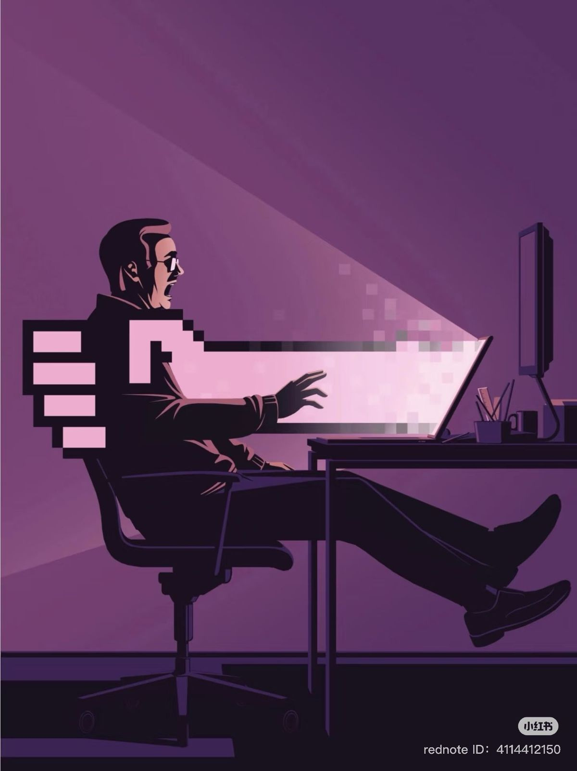
Cyber attack
By: Sara Hatem
Shaza Muhmad
Rawda Ayman
Omar Adl
Mostafa Hossam

Slide 2
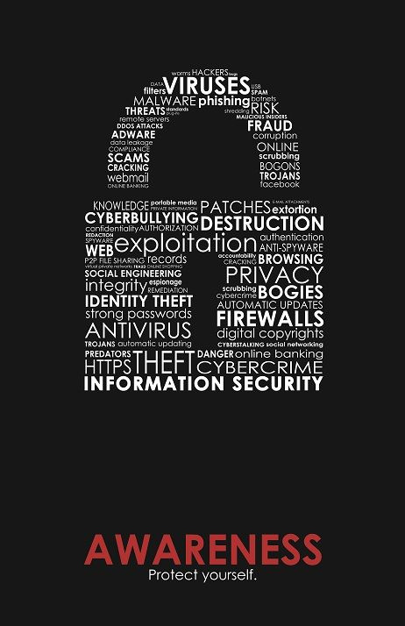

Network security
Network security is as important as your house’s doors and locks.
No network security , then no privacy , more stealing, and more threatening.
2

Slide 3

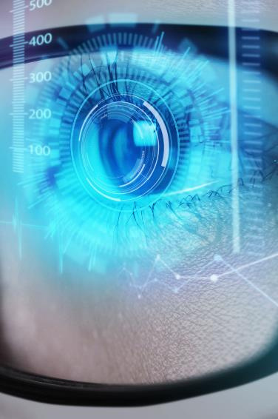
Problem
attacks
Weak security
Bad maintaining
Whenever the security get stronger ,on the other side hackers find new techniques to attack your privacy
Weak security cause easier access and attacks
user wasn’t keeping the actual hardware safe
Costs
Usability
High security is expensive
When using weak security passwords or trust unknown websites
3

Slide 4





CIA Triad
Confidentiality
Integrity
Availability
Keep data private and safe
Only authorized person can view
Protect data from being modified by unauthorized people
Protect data in case of motion and keep it accurate
- Data always available
4
Notes:
4

Slide 5

Confidentiality
Integrity
Encryption
Strong authentication
Biometric authentication
Data hashing
Data backups
Enforced permissions
Monitor file changes
Use power supplies
Solution
Availability
Data redundancy
Data backup
Disaster recovery
5

Slide 6

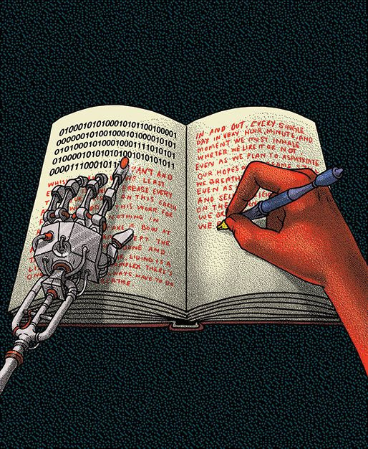
Security components
Firewall
IDS/IPS
VPNs
Encryption
access control
6

Slide 7

Current Cybersecurity Threats & Network Vulnerabilities

Slide 8

Current Cybersecurity Threats
Phishing & Social Engineering
Malware (viruses, ransomware, worms)
DoS/DDoS Attacks
Man-in-the-Middle (MitM)
Insider Threats
​
​
8

Slide 9

Phishing & Social Engineering
Tricks users into revealing sensitive information.
Common via fake emails, websites, or phone calls.
Exploits human trust rather than technical flaws.
10

Slide 10
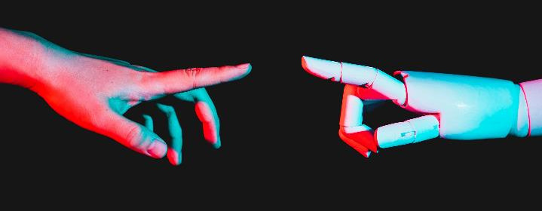
DoS/DDoS Attacks
Denial of Service / Distributed DoS
DDoS (Distributed Denial of Service)
Attack from a single system.
Overloads a server or network with excessive requests.
Easier to detect and block.
Example: One computer flooding a website with traffic.
Attack from multiple compromised systems (botnet).
Much harder to stop because traffic comes from many sources.
Can overwhelm even large organizations.
Example: Thousands of infected devices used to take down a service.
11

Slide 11
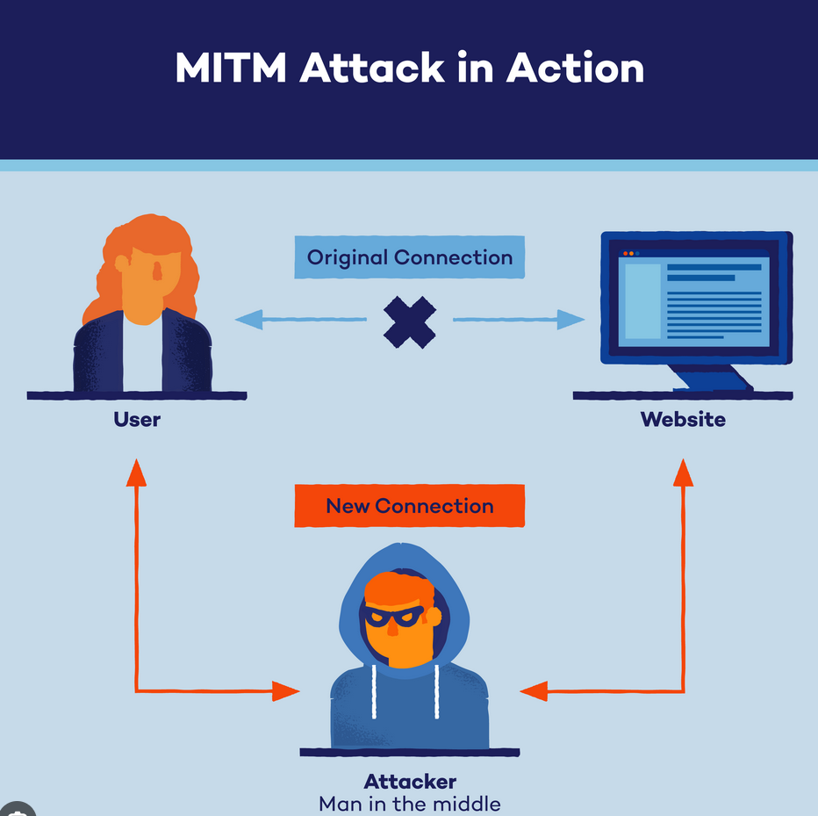
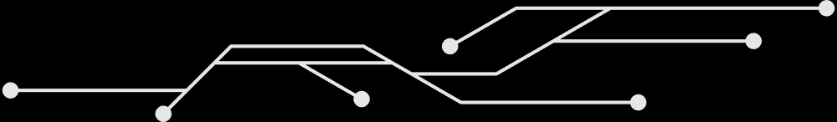
Man-in-the-Middle (MitM)
Attackers intercept communications between two parties.
Can steal login credentials, credit card info, or modify messages.
Often done via insecure Wi-Fi networks.
13

Slide 12
Insider Threats
Denial of Service / Distributed DoS
Threats from employees, contractors, or trusted partners.
May be malicious (data theft, sabotage) or accidental (carelessness).
Harder to detect since insiders already have access.
11

Slide 13

Network Vulnerabilities
Weak Passwords
Unpatched Systems/Software
Misconfigurations
Easily guessable or reused passwords make it simple for attackers to gain unauthorized access.
Missing security updates leave systems exposed to known exploits and vulnerabilities.
Incorrect network or device settings (e.g., open ports, default credentials) can create security gaps.
9

Slide 14
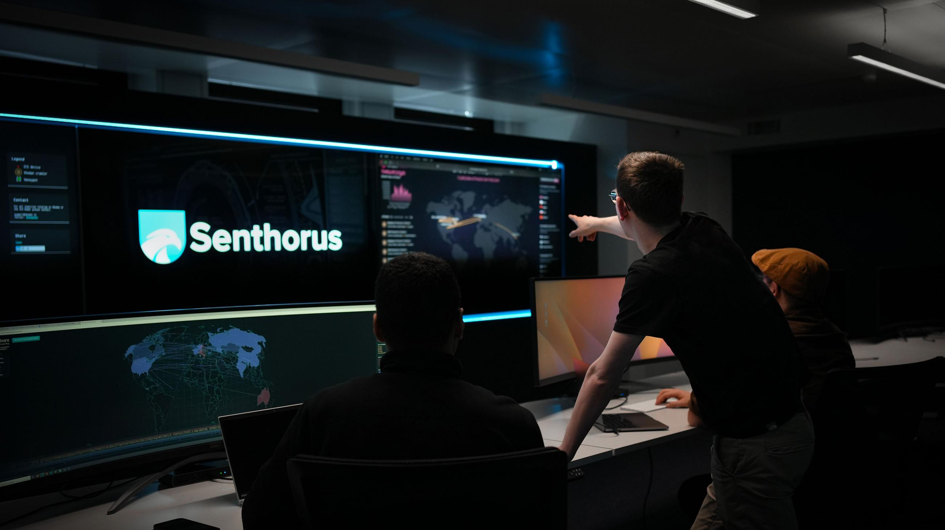
Countermeasures

Slide 15
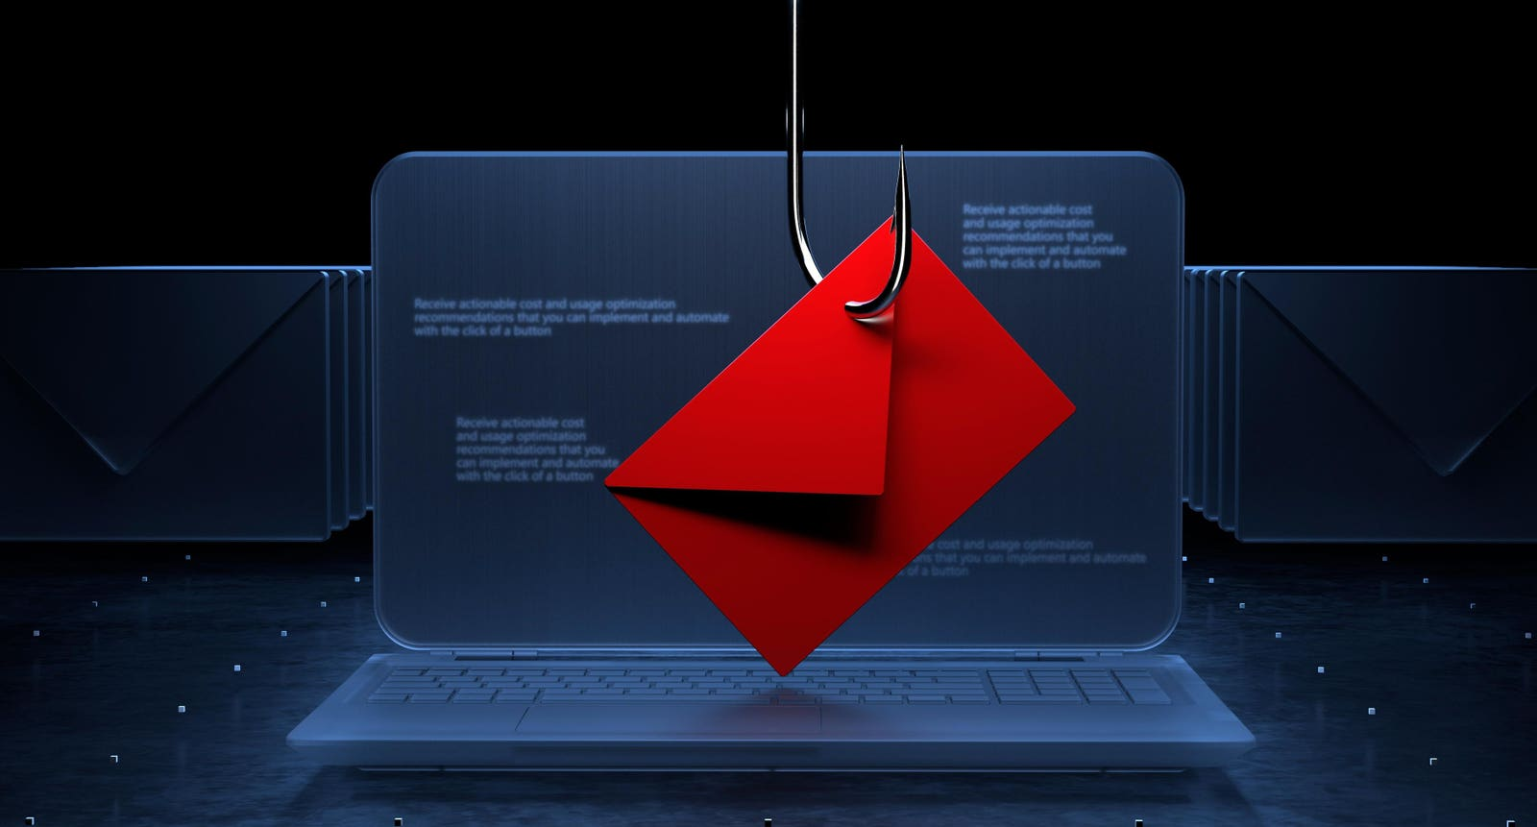
Phishing & Social Engineering Countermeasures
Train Employees
Teach everyone how to spot red flags in emails, such as suspicious links.
Use Strong Authentication
Implement multi-factor authentication (MFA) to require a second form of verification.
3

Slide 16
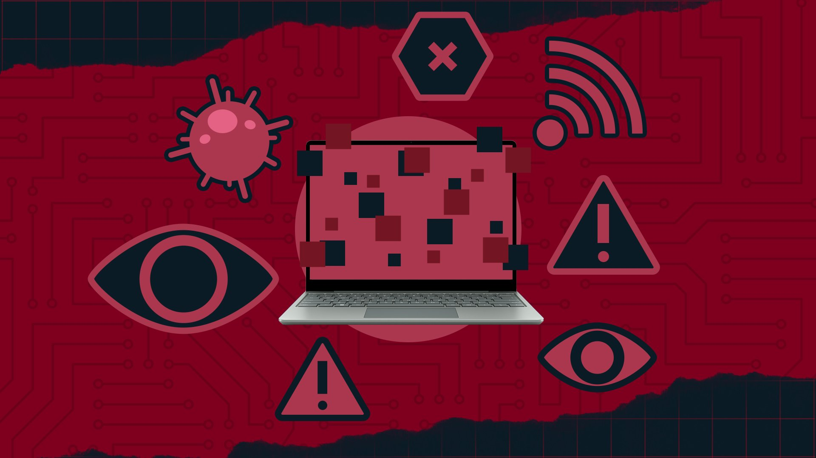
Malware Countermeasures
Install Antivirus Software
Use reputable antivirus and anti-malware software on all devices and keep it updated.
Keep Software Updated
Regularly patch and update all operating systems and applications.
Back Up Data
Regularly back up important data to an external drive or cloud service.

Slide 17
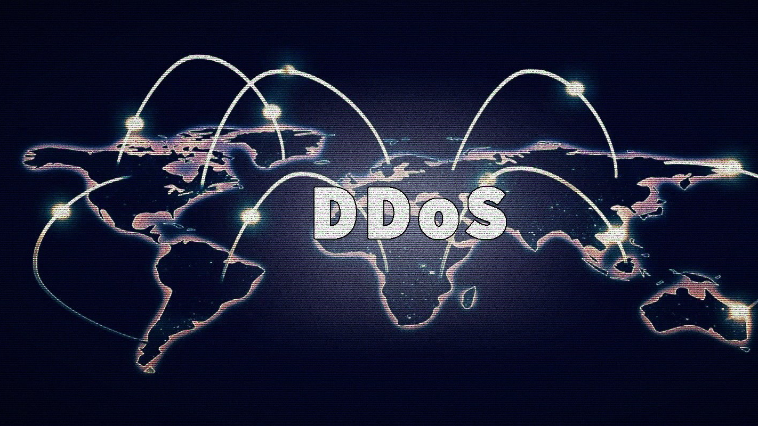
DoS/DDoS Attacks Countermeasures
Use a DDoS Protection Service
Employ a service that can filter malicious traffic before it reaches your network.
Increase Bandwidth
Having more bandwidth can help absorb a larger amount of malicious traffic.
Rate Limiting
Implement rate limiting to restrict the number of requests a single IP address can make in a given time

Slide 18
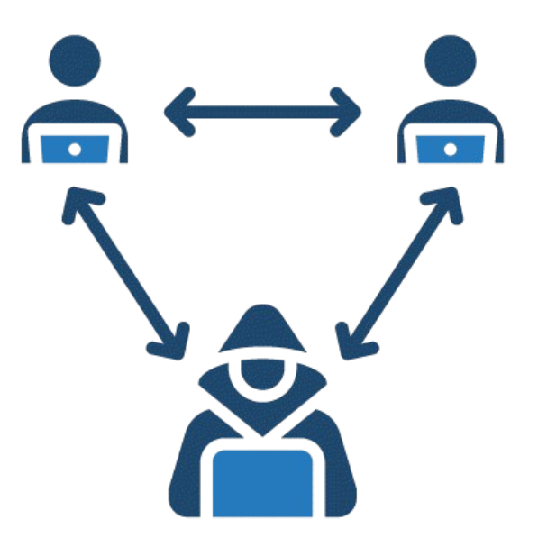
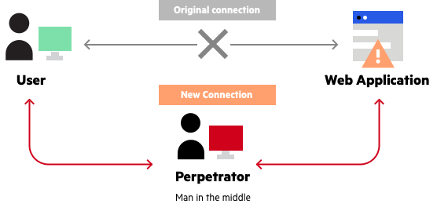
Man-in-the-Middle (MitM) Countermeasures
Use Encryption
Ensure all web traffic is encrypted using HTTPS (Hypertext Transfer Protocol Secure).
Use a VPN
A Virtual Private Network (VPN) can create a secure, encrypted tunnel for your data, protecting it from interception.

Slide 19
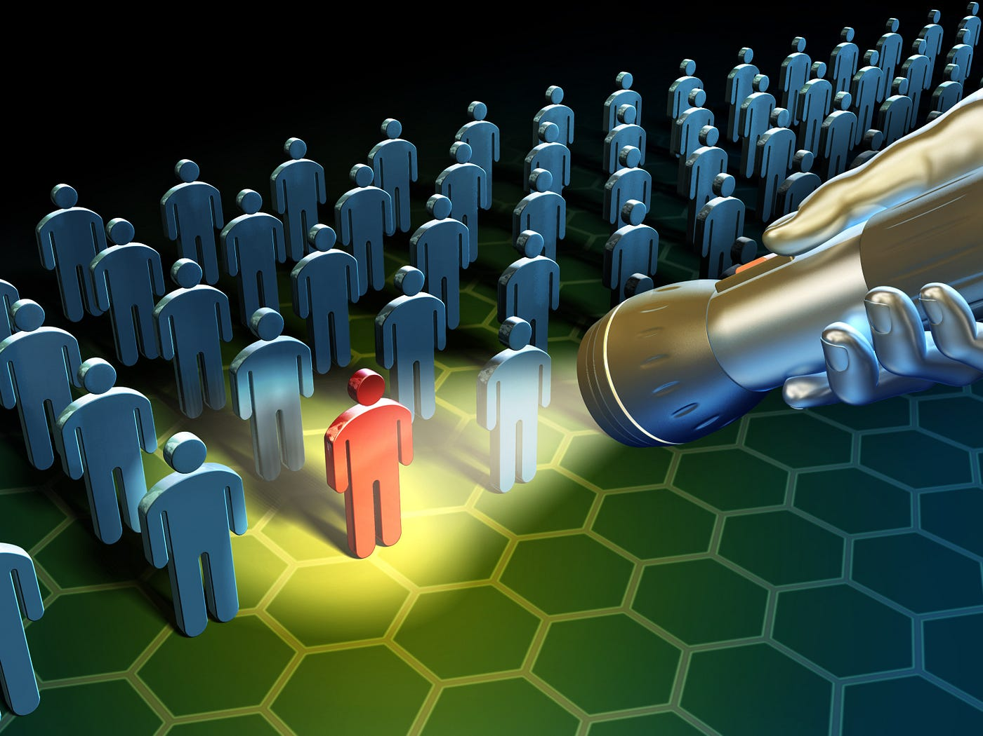
Insider Threats Countermeasures
Implement Principle of Least Privilege
Grant employees access only to the data and systems they absolutely need to do their job.
Monitor Employee Activity
Use tools to monitor for unusual or suspicious behavior, such as a user accessing a large amount of data they normally wouldn't.
Create a Security Culture
Encourage employees to report suspicious behavior and reinforce the importance of data security for everyone.

Slide 20
CASE STUDY
WANNACRY RANSOMWARE ATTACK (2017)
On May 12, 2017 , a massive ransomeware outbreak spread worldwide
Exploited a known Windows vulnerability (EternalBlue / SMBv1)
Altough Microsoft had released a patch two months earlier , many organsizations hadn’t applied it
The ransomeware encrypted files and demanded payment in Bitcoin to unlock them
13

Slide 21
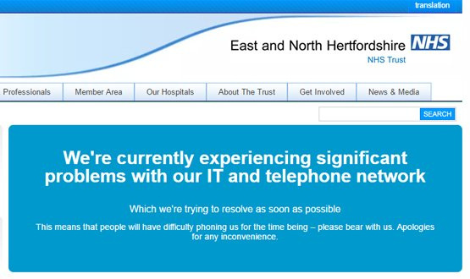
SCALE AND IMPACT
200,000+ systems infected across 150+ countries within days
Victims included large enterprises, hostpitals, small businesses , and individuals
High-profile disruption:
UK National Health Service (NHS) : hospitals shut down, surgeries cancelled
FedEx, Telefonica, Deutshe Bahn also impacted
Estimated global finanical damage: $4-8 billion
14

Slide 22
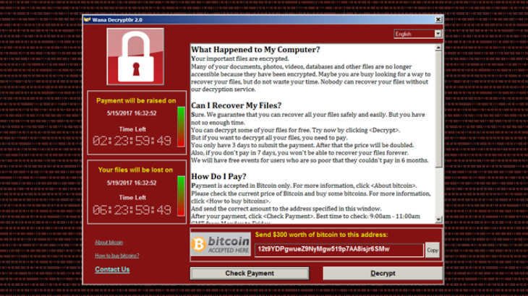
InfeCTION METHOD & VICTIM EXPERIENCE
Likely infection paths:
Phishing emails with malicious attachments
Exposed SMB port (445) on unpatched systems
Victim Experience:
Files encrypted with “.wncry” extension
Ransom note demanding $300 in Bitcoin , doubling after 3 days
THREAT
files permanently lost after 7 days
Installed DoublePulsar backdoor → left systems vulnerable even after removal
15

Slide 23
COnTAINMENT AND MITIGATION
Kill Switch Discovery : security researcher found a “kill switch” domain registering it slowed global spread
Mitigation strategies implemented:
Apply Microsoft MS17-010 patch
Block port 445 at network permiter + disable SMBv1
Segment networks to prevent lateral spread
Deploy anti-malware detection tools
Limitations:
Removal tools could clean malware but could not decrypt files
Some variants appeared without the kill switch
16

Slide 24
LESSONS LEARNED
Patch Management is Critical
Attack succeeded mainly because organizations ignored available security updates.
Defense in Layers
Firewalls, IDS/IPS, backups, and network segmentation must work together.
Human Factor
Security awareness to spot phishing and avoid risky behaviors.
Ransom is No Guarantee
Very few victims - confirmed data recovery after paying.
WannaCry proved that cybersecurity is a continuous process, requiring technology, policy, and awareness.
17

Slide 25
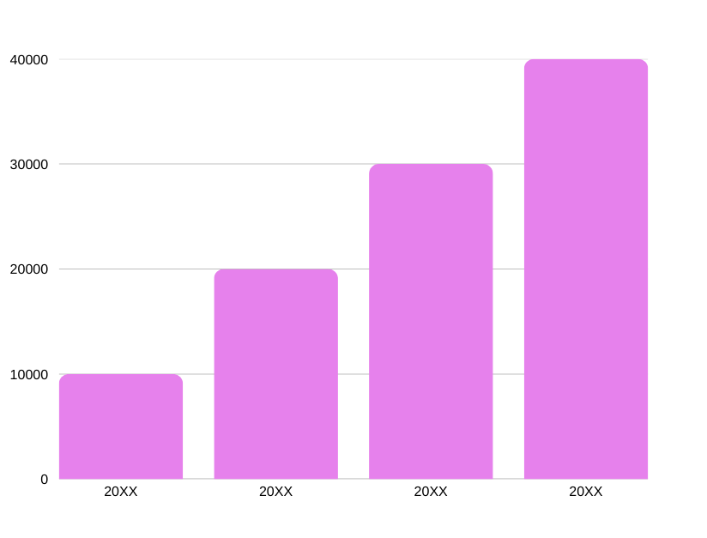
Traction
Forecasting for success​
Key Metrics
Revenue by year
 | clients | orders | Gross avenue | Net revenue
20XX​ | 10​ | 1100​ | $10,000​ | $7,000​
20XX​ | 20​ | 200​ | $20,000​ | $16,000​
20XX​ | 30​ | 300​ | $30,000​ | $25,000​
20XX​ | 40​ | 400​ | $40,000​ | $30,000
15

Slide 26

Two-year action plan
Supply volunteers​
Run focus groups​
Gather feedback​
20XX
Jan
Feb
Mar
Apr
May
Jun
Jul
Aug
Sep
Oct
Nov
Dec
Test with start ups​
Regional launch​
Deliver to consumers​
20XX
Jan
Feb
Mar
Apr
May
Jun
Jul
Aug
Sep
Oct
Nov
Dec
8/06/20XX
PITCH DECK
15

Slide 27

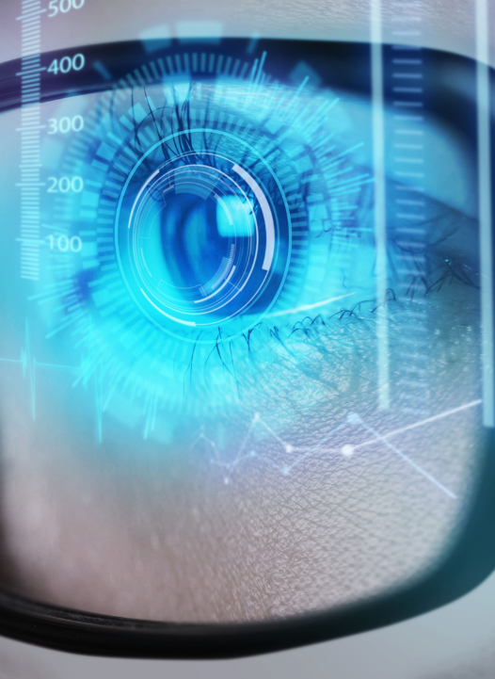
Financials
 | Year 1 | Year 2 | year 3
Detailers​ | 5,000​ | 40,000​ | 160,000​ | ​
Users​ | 50,000​ | 400,000​ | 1,600,000​ | ​
Sales​ | 500,000​ | 4,000,000​ | 16,000,000​ | ​
Average Price per Sale​ | 75​ | 80​ | 90​ | ​
Revenue @ 15%​ | 5,625,000​ | 48,000,000​ | 216,000,000​ | ​
Gross Profit​ | 5,625,000​ | 48,000,000​ | 216,000,000​ | ​
Expenses​ | ​ | ​ | ​ | ​
Sales & Marketing​ | 5,062,500​ | 38,400,000​ | 151,200,000​ | ​
Customer Service​ | 1,687,500​ | 9,600,000​ | 21,600,000​ | 70%​
Product Development​ | 562,500​ | 2,400,000​ | 10,800,000​ | 10%​
Research​ | 281,250​ | 2,400,000​ | 4,320,000​ | 5%​
Total Expenses​ | 7,593,750​ | 52,800,000​ | 187,920,000​ | 2%​
8/06/20XX
PITCH DECK
16

Slide 28


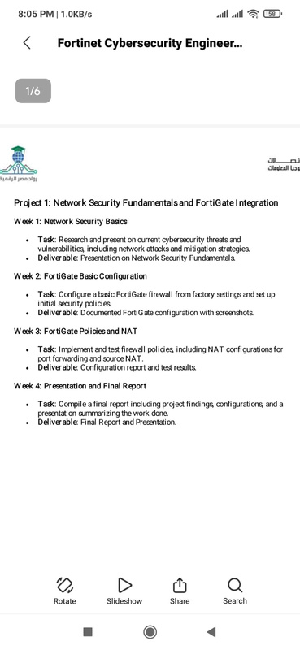
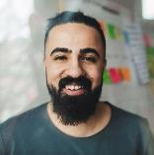
Meet the team
Takuma Hayashi​​
Mirjam Nilsson​​
Flora Berggren​​
Rajesh Santoshi​​
President​
Chief Executive Officer​
Chief Operations Officer​
VP Marketing​
8/06/20XX
PITCH DECK
17

Slide 29




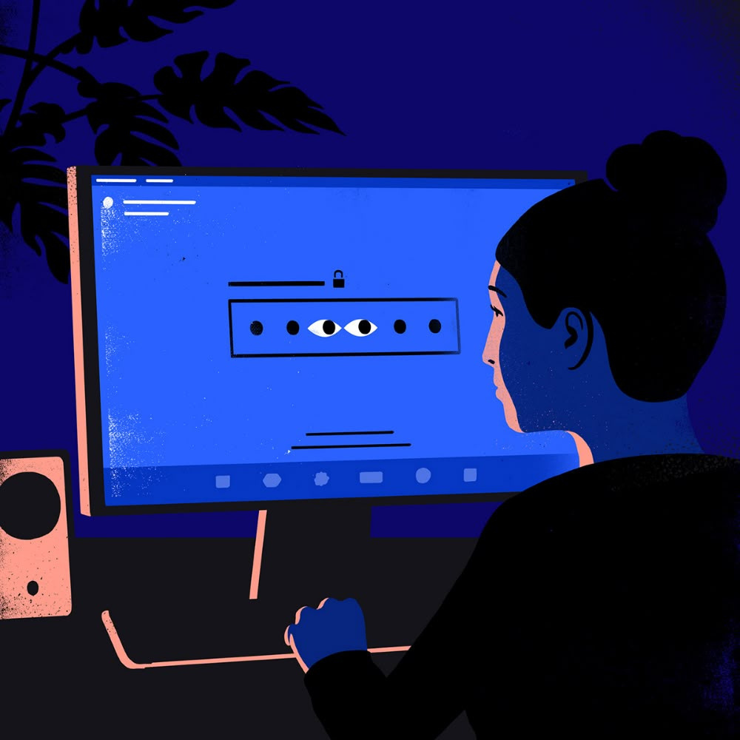
The Full team
Takuma Hayashi​
Mirjam Nilsson​​
Flora Berggren​​
Rajesh Santoshi​​
President​
Chief Executive Officer​
Chief Operations Officer​
VP Marketing​
Graham Barnes​
Rowan Murphy​
Elizabeth Moore​
Robin Kline​
VP Product​
SEO Strategist​
Product Designer​
Content Developer​
8/06/20XX
PITCH DECK
18

Slide 30




Funding
$12K
$14K
$32K
$82K
Campaigns
Angel investments
Cash
Shares
Revenue obtained from online campaigns and reorders
Amount obtained through other investors​
Liquid cash we have
on hand​
Number of shares converted into USD​
8/06/20XX
PITCH DECK
19

Slide 31
Key Takeaways
Strong security requires a balanced approach:
Technology → Firewalls , VPNs , IDS/IPS
Encryption Awareness → User training & phishing prevention
Policy → Clear rules for passwords, updates, and access control
Formula for success:
Technology + Awareness + Policy = Strong Security

Slide 32
SUMMARY
It is important today because of the growth of internet, IoT, and rising cyber threats.
CIA Triad:
Confidentiality → Only authorized access
Integrity → Data remains accurate and unchanged
Availability → Systems always accessible
Key Components: Firewalls, IDS/IPS, VPNs, Encryption, Access Control
Main Threats: Malware (viruses, ransomware, worms), Phishing, DoS/DDoS, Man-in-the-Middle, Insider threats
Vulnerabilities: Weak passwords, unpatched systems, misconfigurations
Countermeasures: Firewalls, updates & patching, MFA, training, encryption
Conclusion: Security is an ongoing process, requiring technology, awareness, and policies
Thank you

